Slide 1
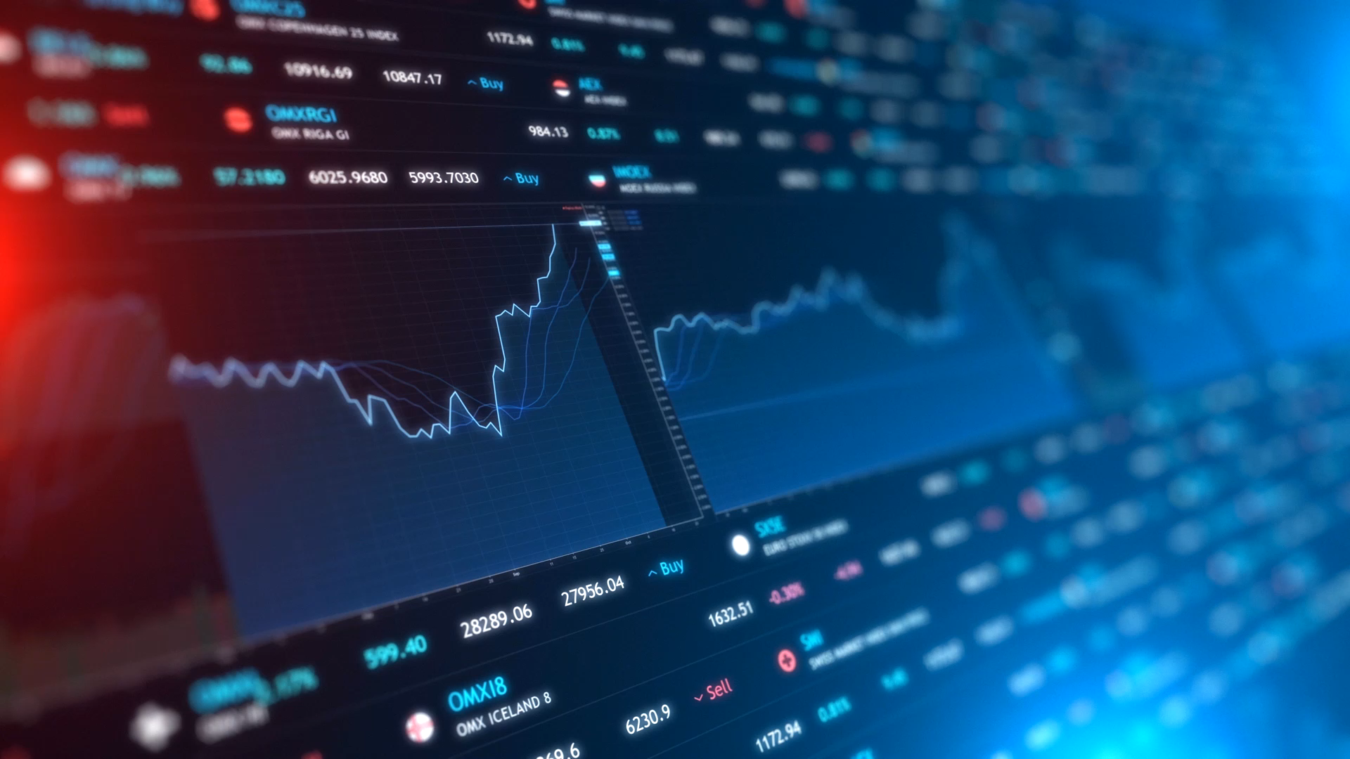
Systematic Trading Education Certificate Lecture 1

Slide 2
Outline of the STEC
Session 1 Introduction - 5th March
Introduction to systematic trading and financial basics
Momentum strategies including relative and cross sectional momentum
Session 2 Mean Reversion - 12th March
Mean reversion strategies and Fibonacci strategies
Value strategies
Session 3 – 19th March
ML models
Sentiment analysis

Slide 3
Financial Securities Overview
Stocks
Commodities
Shares of publicly traded companies
Raw materials that are easily bought and sold.
Systematic strategies focus on commodity futures as this avoids potential storage costs and their liquidity
Bonds
Government issued bonds like US T-Bills
Corporate bonds
Derivatives
FX Rates
Financial products whose value depend on other securities.
Examples include futures, call and put options
More exotic derivatives can be traded but tend to be more illiquid
FX trading or currencies trading aims to make money from changes in currency exchange rates.
Index Futures
Index futures track portfolios of stocks or bonds weighted to follow a certain financial market index. e.g. S&P 500 or FTSE 100
Systematic strategies often trade baskets made up of assets from multiple asset classes.

Slide 4
What is Systematic Trading?
DEFN: A method of trading using automation and computer programmes to either execute trades on an exchange or run specially designed trading algorithms.
Fully Automated
Partially Automated
No human interaction with the programme responsible for producing buy sell signals and placing these orders.
programme produces buy/sell signals with the investor then able to make the final decision as to proceeding with the trade.
Include High Frequency Trading (HFT or algorithmic trading) but also systematic trend following and passive index tracking.
Partially automated strategies include index tracking and systematic trend following usually over large time periods.

Slide 5
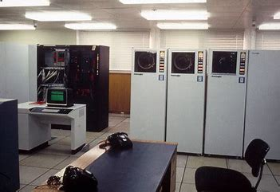

Historical Background
Systematic trading began in the 1970s with the Designated Order Turnaround (DOT) electronic system used by the NYSE to place orders.
In the 1990s systematic trading took off with major financial institutions developing systematic strategies.
As computing power and speed increased HFT strategies became more popular in the 2000s.
Now, approximately 60% of all trades are placed by computer algorithms with quantitative trading firms able to place millions of trades within seconds.

Slide 6
The process of making a trading strategy
Research
Development
Backtesting
Deployment
Consider what securities to design a strategy around.
Investigate potential Alpha generating factors.
Develop the theory behind a strategy.
Put your theoretical strategy into code.
Removal of any coding bugs.
Test the effectiveness of your strategy.
Use previous securities price data to see how the strategy would have performed
Finally you're able to deploy the algorithm.

Slide 7
Diagram of the Fully Automated Deployment Process
Trading algorithm
Financial Markets
ORDERS
API
Buying and selling
Broker
Calculation of optimal portfolio weights
Calculation of technical indicators
CLEAN
Data Provider

Slide 8
Types of trading strategies

Slide 9
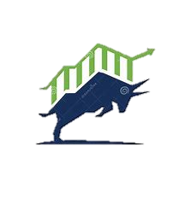
Momentum
Momentum strategies involve using the past performance of stocks as a model for future performance or trend following. The main concept is to buy the well performing stocks.
Some of the easiest strategies to understand and implement.
Relative Momentum
Time Series Momentum
Relative momentum Strategies involve comparing relative performance across a basket of securities.
Cross sectional strategies do not involve comparison of returns across a basket.
Take long positions in the better performing stocks but shorting the worst performing stocks irrespective of individual returns.
Take long positions in the securities with positive historic returns and shorting securities with negative historic returns.

Slide 10
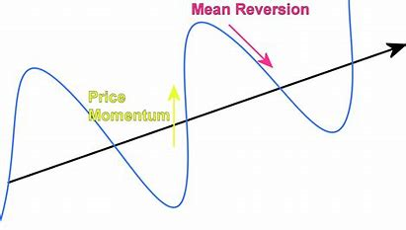
Mean Reversion
Strategy based on the principle that an asset will eventually revert back to some “mean value”. (Note this need not be stationary and very rarely is).
Various metrics can be used to give information about whether a stock is above or below its mean value.
Pairs trading is also a form of mean reversion which is a strategy that focusses on two strongly correlated stocks. If at some point there are differences in price short the overvalued stock and go long in the undervalued in the belief these will converge.

Slide 11

Statistical Arbitrage
Statistical Arbitrage uses various quantitative and statistical techniques to identify and exploit arbitrage opportunities that arise from the mispricing of securities.
An Arbitrage is a portfolio with 0 initial capital which has a positive probability of making positive returns without any risk of negative returns.
These opportunities don’t last for long as there are many large institutions trying to take advantage of this strategy which eventually leads to price changes in the markets and no more arbitrage
Arbitrage opportunities also occur in betting markets. A popular example is matched betting

Slide 12
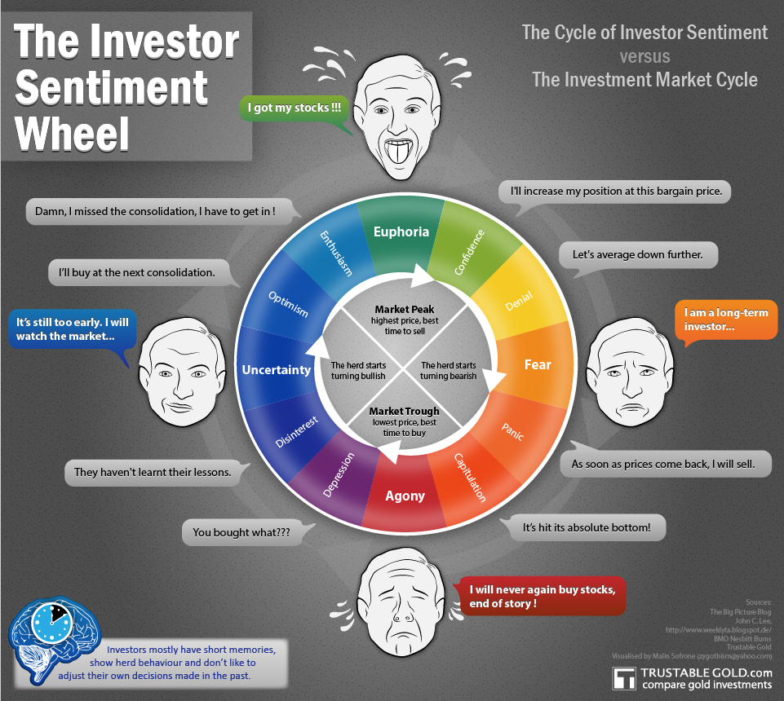
Sentiment Analysis
Sentiment analysis uses machine learning and natural language processing to model investor sentiment so involves looking at news feeds and other external non-mathematical factors and then use advanced machine learning and NLP techniques to predict price trends.
With these strategies it is important to get news ASAP. This is part of the reason why institutions pay such large fees for access to products like Bloomberg terminal or investment bank market research papers.

Slide 13
Execution Algorithms
For individual investors buying or selling shares will have little to no impact on share prices. However for institutional investors this is not the case and investment firms use brokers to get better prices for trades
The arrival price is defined as the price of a trade at the start of execution by a large financial institution and serves as a benchmark for final trade price
Important factors that effect the success of an execution include:
Price
Fees
Information Leakage
Execution timeframe
Ideally institutions would like to buy for lower than asking price or sell for above the bid price although this often is not the case and will usually aim to buy or sell close to the arrival price.
Institutions are able to achieve this using various complex algorithms . However many of these algorithms are based on the measures of Volume Weighted Average Price (VWAP) and Time Weighted average price (TWAP).

Slide 14
Technical Indicators
A technical indicator is a mathematical calculation using data from previous security prices
Comparing different technical indicators is often the underlying principle behind many trading strategies.
Overlays
Oscillators
Indicators that use the same scale as the security price and can be plotted on the same graph as the stock price.
Indicators that tend to oscillate between a min and max value with the scale not comparable to the stock price.
Examples include simple and exponential moving averages and Bollinger bands
Examples include the relative strength index (RSI), Stochastic Oscillator and moving average convergence divergence (MACD).
There are thousands of defined technical indicators that all have different features and can be useful dependent on the type of security being traded and the desired outcomes of the investor.

Slide 15
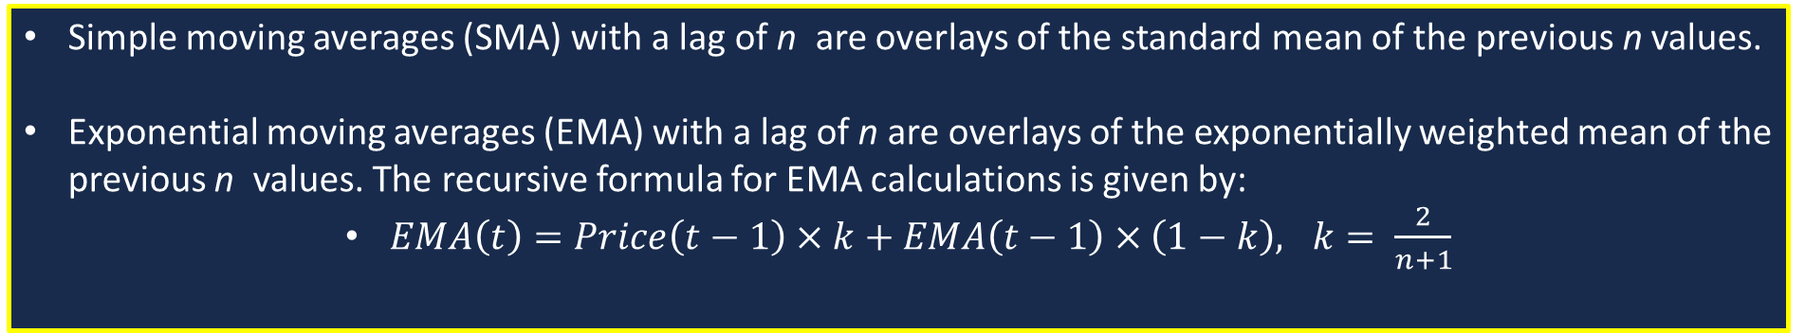
A few Common Overlay Indicators
Simple and Exponential moving averages
Simple moving averages (SMA) with a lag of n are overlays of the standard mean of the previous n values.
Exponential moving averages (EMA) with a lag of n are overlays of the exponentially weighted mean of the previous n values. The recursive formula for EMA calculations is given by:
$EMA\left(t\right)=Price\left(t−1\right)×k+EMA\left(t−1\right)×\left(1−k\right), k= \frac{2}{n+1}$
Bollinger Bands
Bollinger Bands are a pair of bands that form an envelope and give a sense of the high and low values of the stock price.
They are calculated from a simple moving average with the upper and lower bands being calculated by respectively adding and subtracting a multiple of the standard deviation to the simple moving average. Usually this multiple is 2.

Slide 16
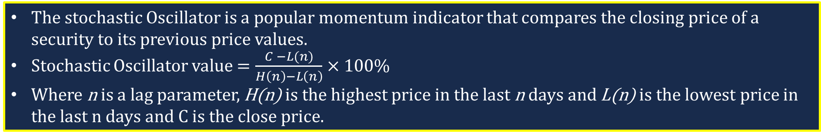
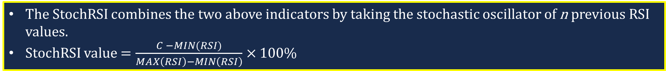
A few Common Oscillator Indicators
Relative Strength Index
RSI is an indicator that signals the extent to which a security is under or overbought.
$RSI=100 −\left(\frac{100}{1+\frac{ average of gains over n previous vals}{ average of losses over n previous vals }}\right)$% (with lag parameter n commonly equal to 14)
Stochastic Oscillators
The stochastic Oscillator is a popular momentum indicator that compares the closing price of a security to its previous price values.
Stochastic Oscillator value $=\frac{C −L(n)}{H\left(n\right)−L\left(n\right)}×100\%$
Where n is a lag parameter, H(n) is the highest price in the last n days and L(n) is the lowest price in the last n days and C is the close price.
Stochastic Relative Strength Index
The StochRSI combines the two above indicators by taking the stochastic oscillator of n previous RSI values.
StochRSI value $=\frac{C −MIN(RSI)}{MAX\left(RSI\right)−MIN\left(RSI\right)}×100\%$

Slide 17
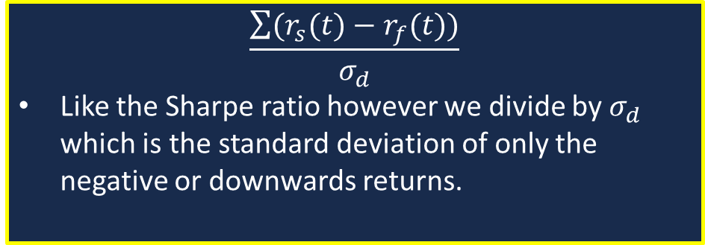
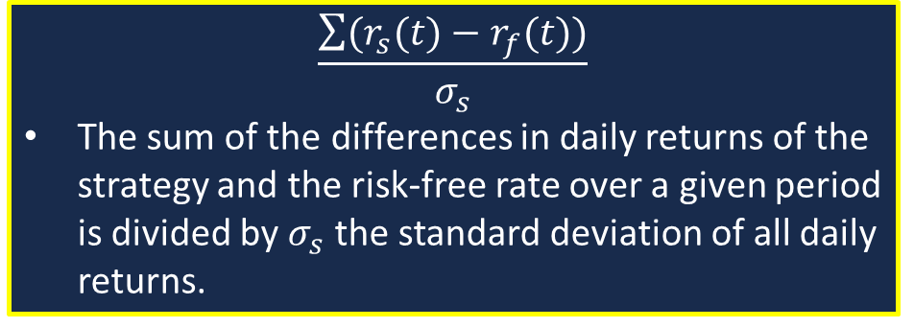
Strategy Evaluation
Once we have coded a strategy we want to measure its performance during backtesting.
We could just consider total returns however this gives no information about how volatile a strategy is.
Instead it is better to consider ways of calculating risk adjusted returns.
Two common measures of risk adjusted returns are the Sharpe and Sortino Ratios.
These measures are able to be applied to any strategy backtest, irrespective of what underlying assets are traded.
This allows for direct comparison of any strategies.
Sharpe Ratio
Sortino Ratio
$$\frac{\sum{(r_{s}(t)−r_{f}(t))}}{σ_{s}}$$
The sum of the differences in daily returns of the strategy and the risk-free rate over a given period is divided by $σ_{s}$ the standard deviation of all daily returns.
$$\frac{\sum{(r_{s}(t)−r_{f}(t))}}{σ_{d}}$$
Like the Sharpe ratio however we divide by $σ_{d}$ which is the standard deviation of only the negative or downwards returns.

Slide 18
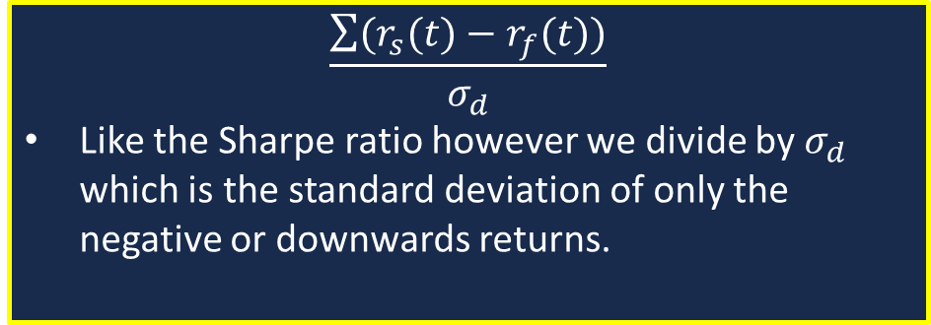
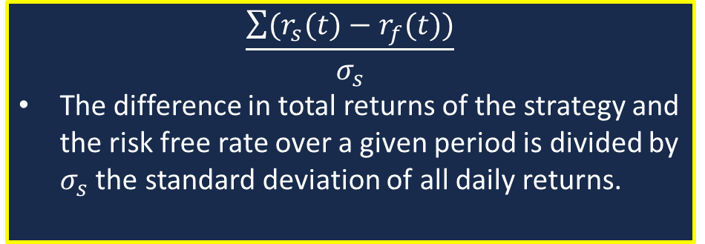
Strategy Evaluation
Although Sharpe and Sortino ratios are useful due to their generality, it is often necessary to compare a strategy’s performance to a benchmark index.
Comparing to a specific benchmark is often very useful but due to the
Sharpe Ratio
Sortino Ratio
$$\frac{\sum{(r_{s}(t)−r_{f}(t))}}{σ_{s}}$$
The difference in total returns of the strategy and the risk free rate over a given period is divided by $σ_{s}$ the standard deviation of all daily returns.
$$\frac{\sum{(r_{s}(t)−r_{f}(t))}}{σ_{d}}$$
Like the Sharpe ratio however we divide by $σ_{d}$ which is the standard deviation of only the negative or downwards returns.
Considers both upwards and downwards volatility as problematic
Considers only downwards volatility as problematic

Slide 19
Time to Code

Slide 20
Todays coding task
Develop and backtest both a cross sectional and relative momentum strategy.
Implement a weighting scheme as an extension to one of the models above.
Develop code that successfully calculates the Sortino ratio
If you didn’t receive an email about accessing skeleton code then raise your hands.

Slide 21
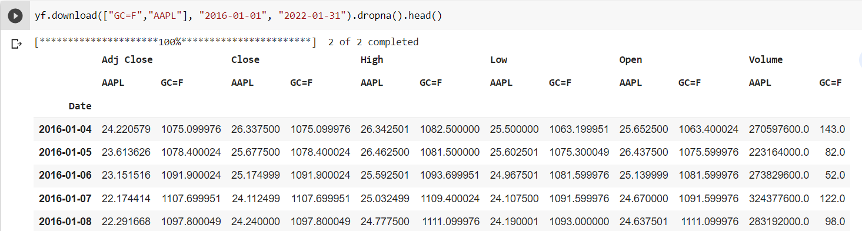
Useful Information on the yFinance Module
The yFinance module imports data from Yahoo Finance into the following Pandas DataFrame.
The default index for this data set is daily
The columns represent daily quantities including the Open, Close, Adjusted Close, Low and Open prices and Trading Volume.
We use the Adjusted close as the value of buying and selling securities when backtesting
The sub-columns represent the individual assets

Slide 22
Conclusions
At the end of each session I’ll try to provide info about further reading material.
Time Series Momentum - Breaking Down Finance
An interesting article that compares time series and cross sectional momentum
https://www.quantconnect.com/
Quant Connect is the platform we choose to deploy some of our strategies that the systematic fund has developed
Easy to use API and supports programming in Python.
The tutorial series provides excellent information on how to get started with the platform and the basics of systematic trading
Thank you all for coming to our first session!!

